Slide 1
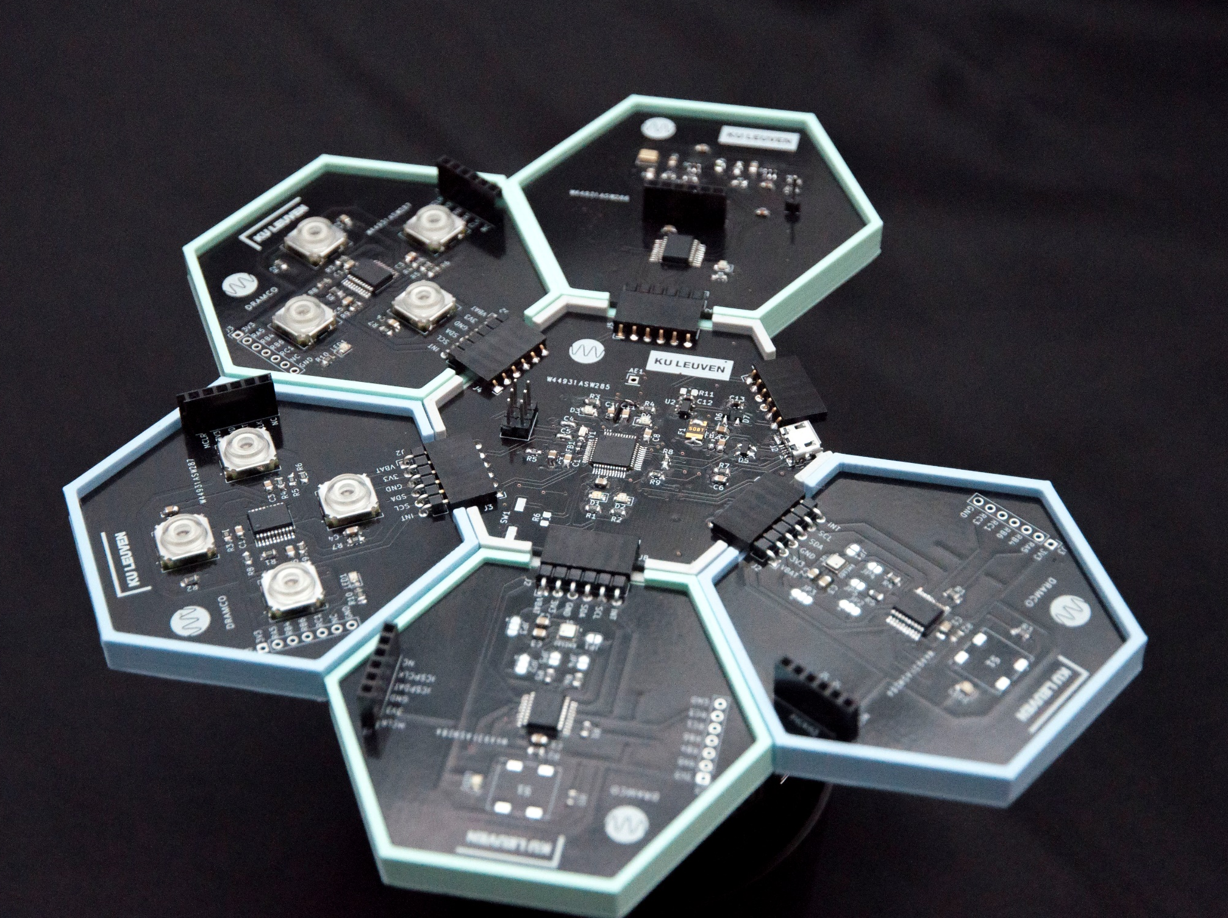
‘IoT with a soft touch’ STEM project: engaging youngsters to deploy technology for sustainability goals
‘IWAST’ team of KU Leuven – DRAMCO
https://dramco-iwast.github.io/handleiding-voor-leerkrachten

Slide 2







Youngsters care about environmental and societal problems

Slide 3






How youngsters do (not) embrace technology…
Used on a daily basis by a diversity of people, for keeping in contact, following up health, commodity that can not be missed, personal items relied on
Few youngsters interested in technology, considered part of the problem rather than a solution for societal (environmental) challenges, poor diversity in STEM studies

Slide 4
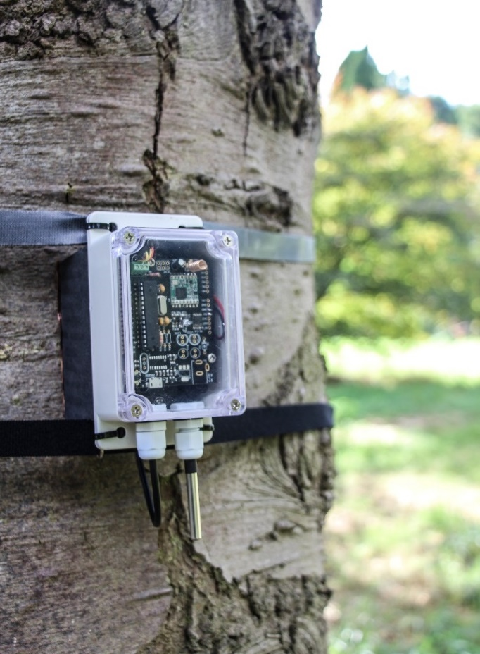
IoT-technology can help to address ‘hard’ problems in ‘soft‘ themes
In the Internet-of-Things (IoT), ‘things’ mostly talk about what they ‘sense’
and could think about what they sense

Slide 5


‘IoT with a soft touch’ (IWAST): double meaning
‘Soft’ matters:
Experiments to monitor and study societal problems that matter to young people
‘Soft’ entry:
We removed hurdles to engage a diverse community – beyond the a priori interested

Slide 6
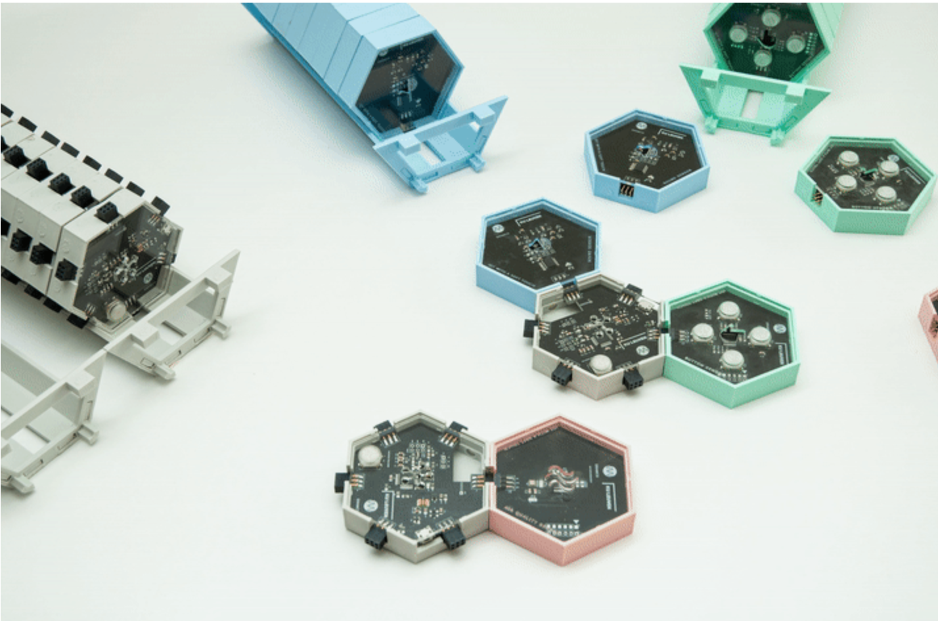
Launching: ‘IoT with a soft touch’ plug-and-play pack and ample hardware components:
sensor modules: noise, air, buttons,
radios and central controller
gateway
portal - dashboard

Slide 7


Paving the way to a positive experience with technology, stimulating initiative and creativity
Lowering technological hurdles for an easy exploration:
Ready-made sensor boards/dashboard to monitor/process/analyse data and configurator to configure the sensor(s) behaviour, …
Offering support:
Tutorial-style material on IoT and the packages and tools, guidelines for students and teachers, introductory workshop and feedback session, …

Slide 8






IWAST can contribute to the Sustainable Development Goals
For the target group:
With the experiments:

